Slide 1
CISC 667
Introduction to Autonomous Driving
Lecture 8
Nov 10, 2025

Slide 2
Today’s Outline
Planning Algorithms
Global Planning

Slide 3
Global Planning Algorithms
Visualization: https://qiao.github.io/PathFinding.js/visual/

Slide 4
Dijkstra’s Algorithm
Goal: Shortest path(s) from a start node on a graph with non-negative edge weights.
Idea: Grow a frontier; always expand the node with the smallest current cost dist. Once expanded, its cost is final.
Mechanics: Keep dist[] (∞ except start=0), parent[], and a min-heap keyed by dist.
Relaxation: When you expand u, for each edge (u→v, w), if dist[u]+w < dist[v], update dist[v], set parent[v]=u, and push v to the heap.
Stop: For a single goal, stop when the goal is popped; otherwise continue until the heap is empty. Reconstruct the path via parent.
Why it’s correct: No negative weights ⇒ costs are non-decreasing when popped ⇒ optimal.
Cost: ~O((V+E) log V) with a binary heap.

Slide 5
A* Algorithm
Goal: Optimal path start→goal on a graph with non-negative edge costs.
Rule: Expand the node with smallest f(n) = g(n) + h(n).
g(n): exact cost-so-far; h(n): heuristic lower bound to the goal.
Optimality: If h is admissible (never overestimates). Consistency (triangle inequality) avoids reopens.
Steps: Init g(s)=0; push s. Pop lowest-f node u; if u is goal → stop. For each neighbor v, if g[u]+w < g[v], update g[v], set parent[v]=u, push with new f.
Relation to Dijkstra: h ≡ 0 ⇒ A* reduces to Dijkstra. Tighter h ⇒ far fewer expansions.
Heuristics: Grids—Manhattan/Euclidean; Road graphs—landmarks/ALT; Car-like—Dubins/Reeds–Shepp lower bounds.
Pitfalls: Negative edges; overestimating h (loses optimality); inconsistent h (may require reopens).
Cost: ~O((V+E) log V) with a heap; explored nodes depend on heuristic quality.

Slide 6
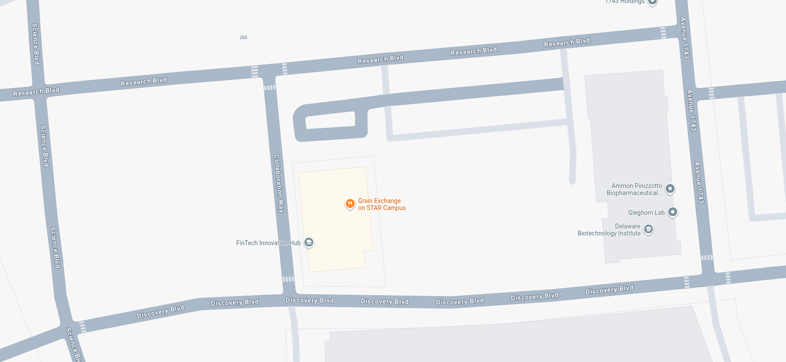
Exercise
Turns
BAM->3
MAB->2
AML->3
LMA->2
ABL->2
LBA->3
LBC->2
CBL->2
MLB->3
BLM->2
LKJ->3
JKL->2
JID->3
DIJ->2
BCH->2
HCB->3
CHE->3
EHC->2
HGF->2
FGH->2
IDE->3
Turns
EDI->2
DEH->2
HED->3
EFG->2
GFE->2
EHG->3
GHE->2
CDE->1
EDC->2
Horizontal
ABC->0
CBA->0
BCD->0
DCB->0
CDI->0
IDC->0
MLK->1
KLM->1
4
3
3
5
3
I
4
D
2
2
C
2
2
B
3
3
3
4
5
5
E
2
A
H
3
2
J
3
5
F
G
5
4
4
4
4
4
4
6
Vertical
CHG->2
GHC->2
DEA->2
AED->2
IJK->0
4
K
L
6
M
4

